Slide 1
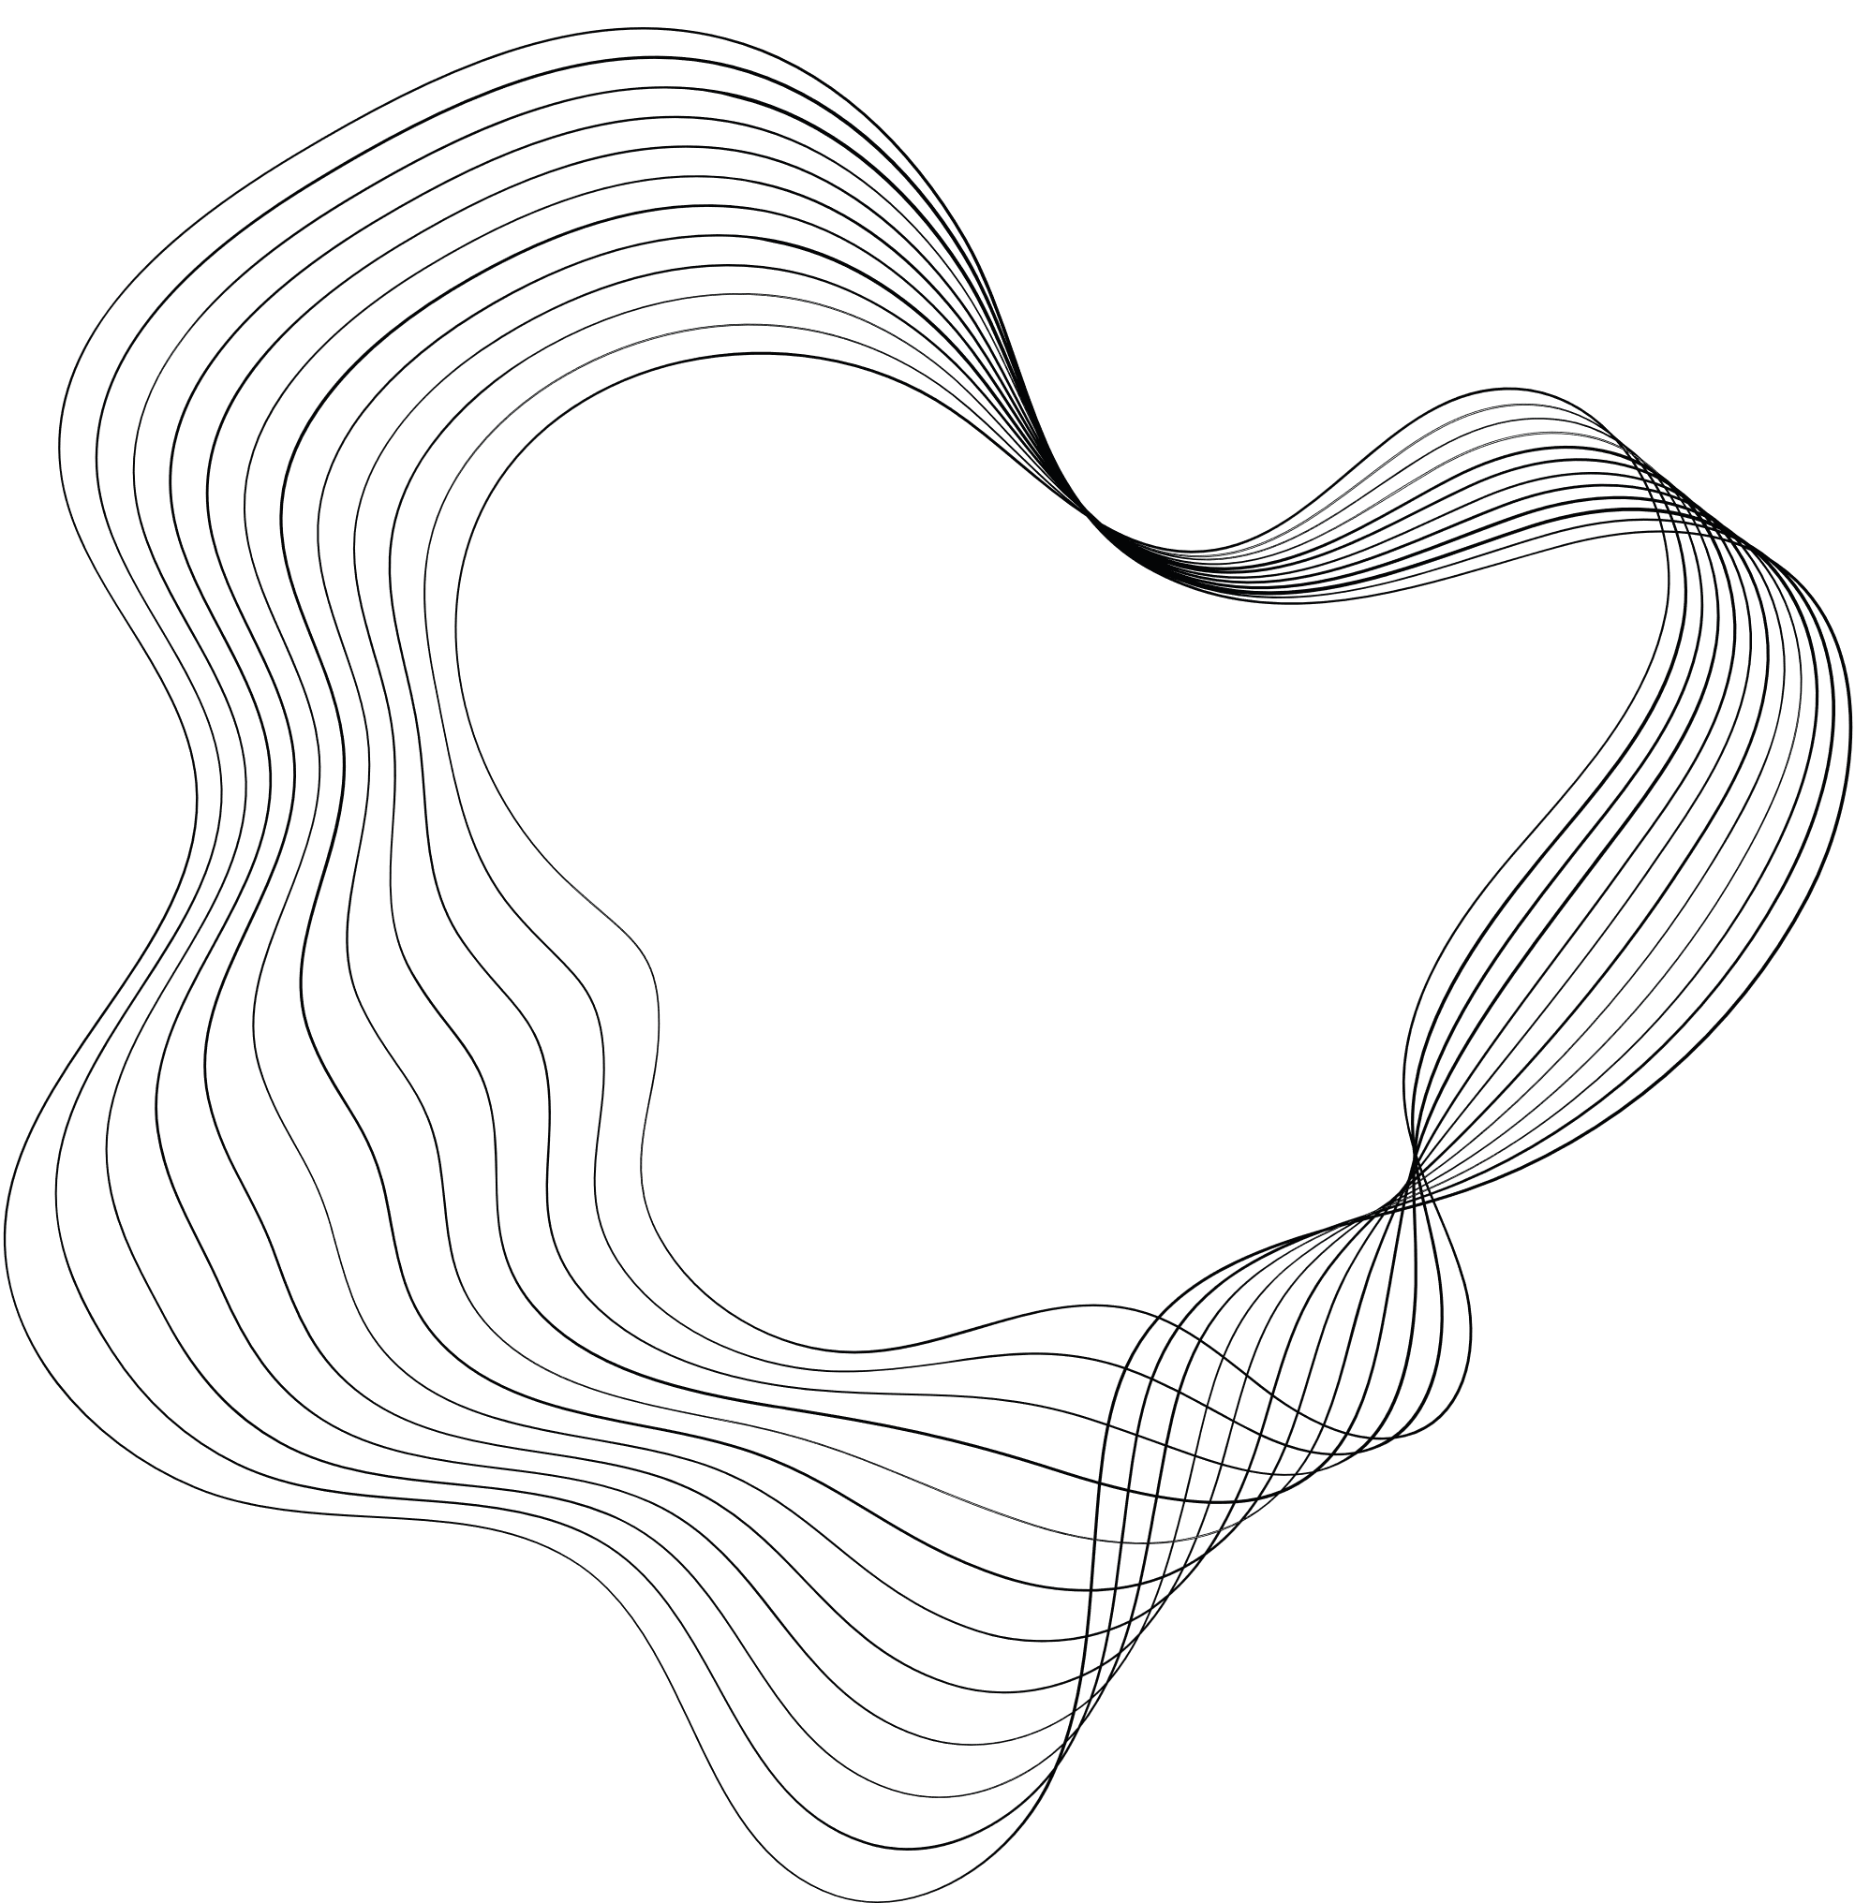
Forest Fire Prediction
IBM PROJECT

Slide 2
Aim:
The main Purpose of this project on Forest Fire Prediction is to Predict using image data whether, it is a fired image or non-fired image. The model will be trained using CNN which will predict accurate results on Forest Fire which can be useful in real-time for forest officers to take care of dense forest regions.

Slide 3
Dataset Description:
Dataset is taken from kaggle
https://www.kaggle.com/datasets/phylake1337/fire-dataset
This Dataset was used to train the model for predicting accurately.
About Dataset: The data is separated into two folders: non-fire_images, which has 244 nature images (such as forests, trees, grass, rivers, people, foggy forests, lakes, animals, roads, and waterfalls), and fire_images, which has 755 outdoor fire photos, some of which include significant smoke.
https://www.kaggle.com/datasets/atulyakumar98/test-dataset
This Dataset images is used in our project to test the accuracy of model on unseen data.

Slide 4
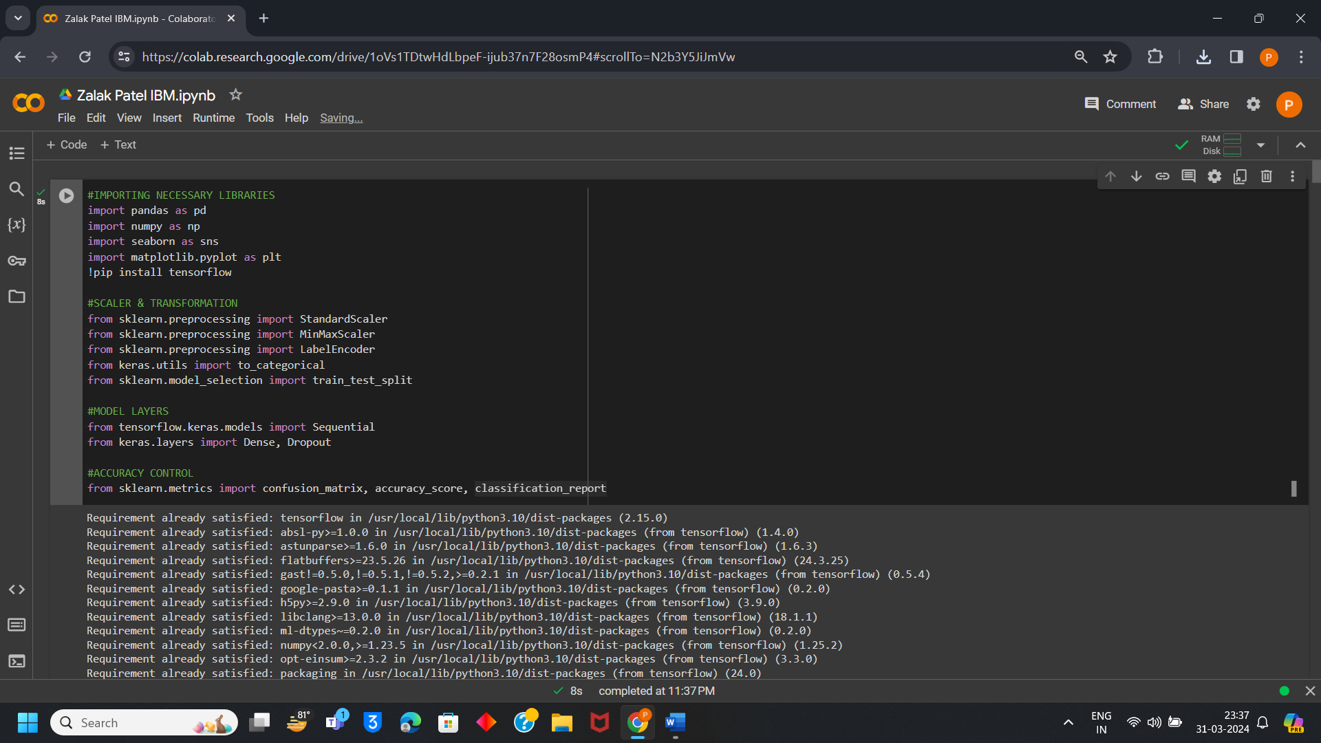
Importing necessary libraries:

Slide 5
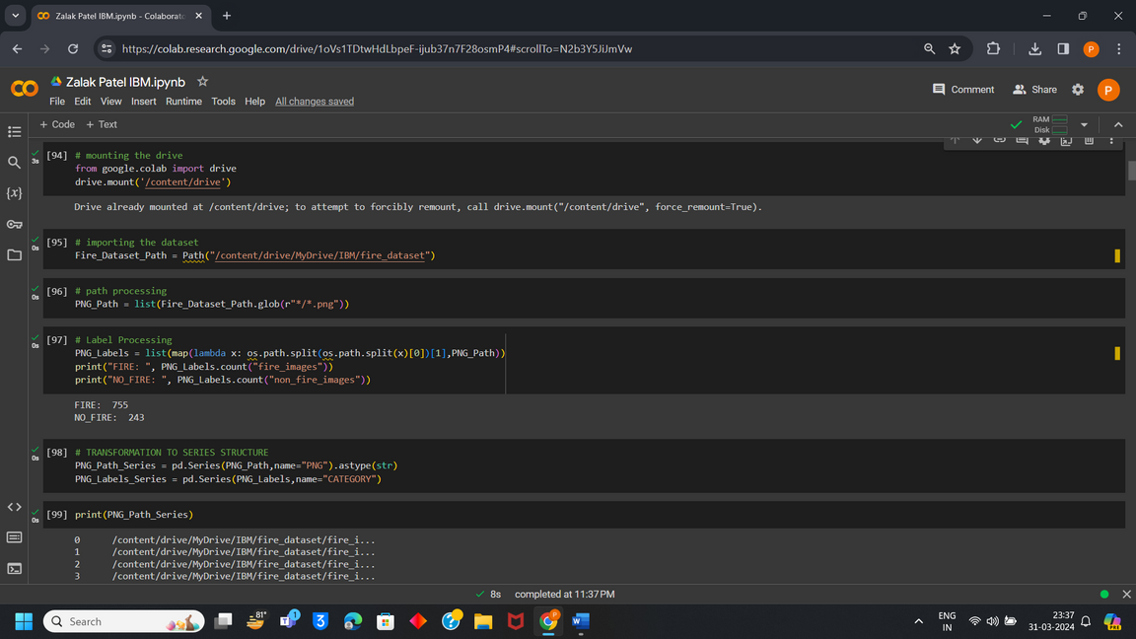
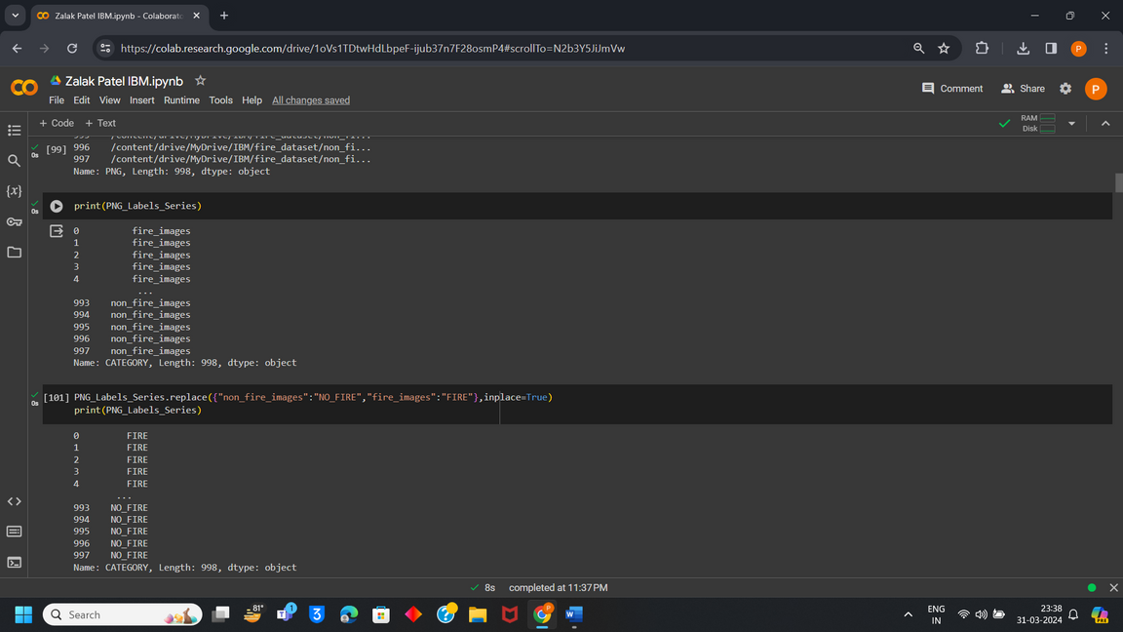
Importing Dataset:

Slide 6
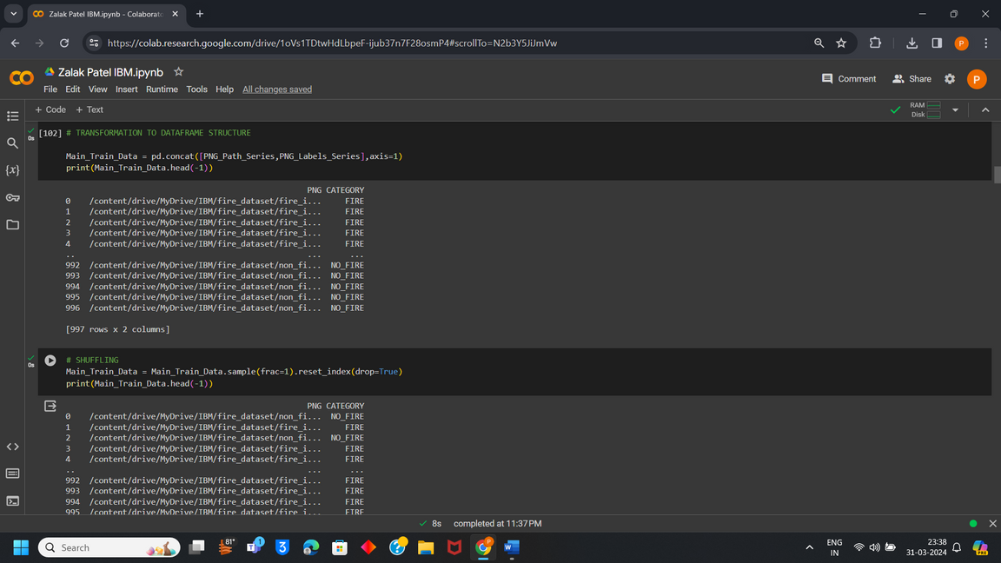
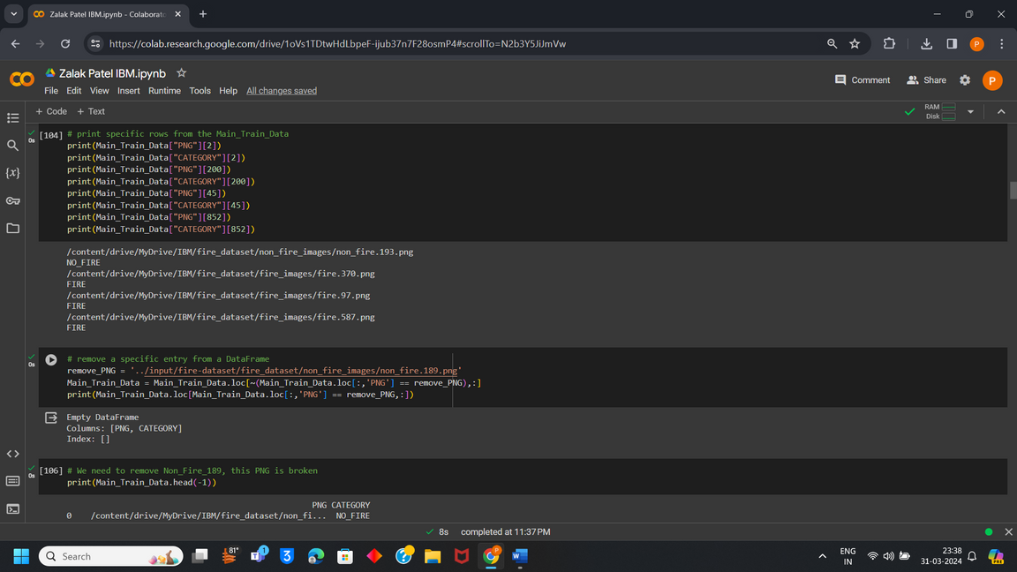
Preprocessing Data:

Slide 7
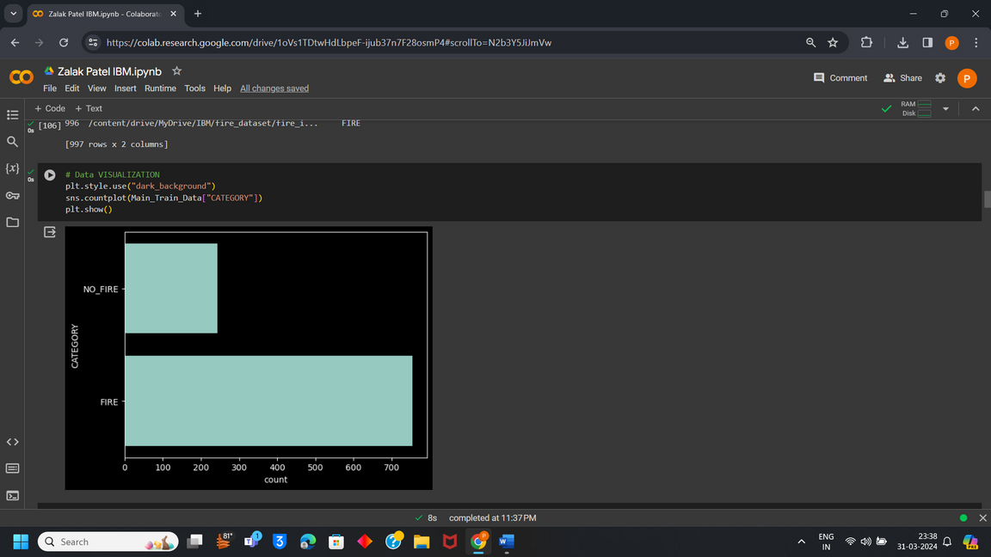
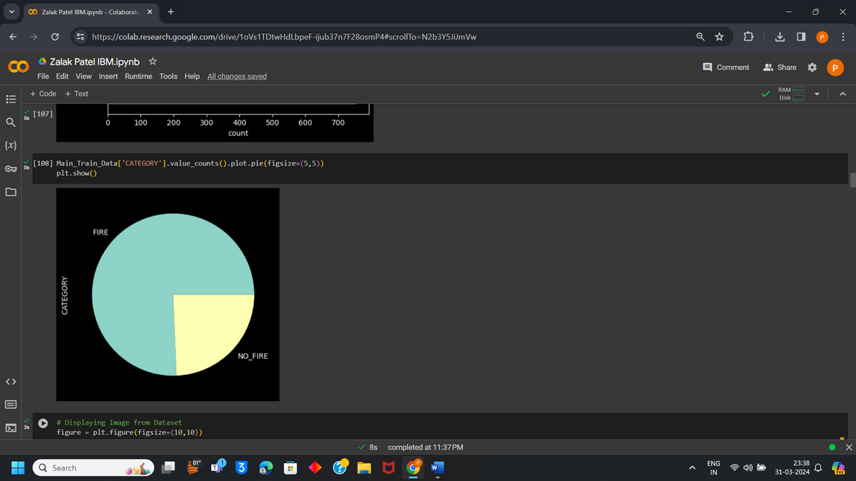
Data Visualization:

Slide 8
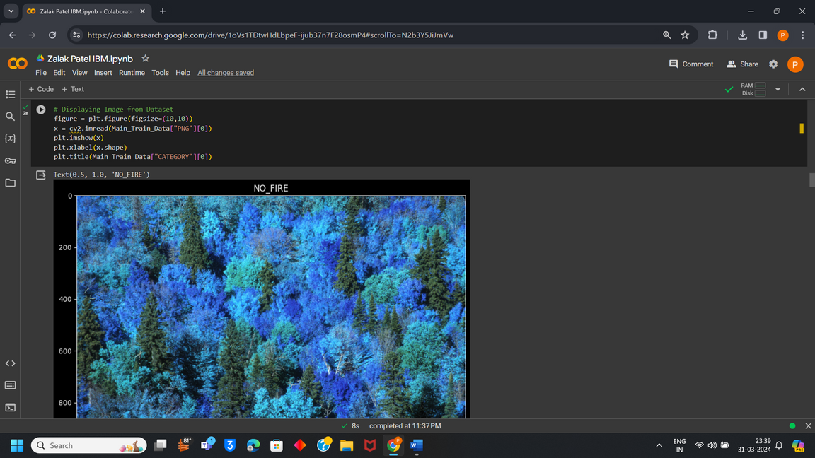
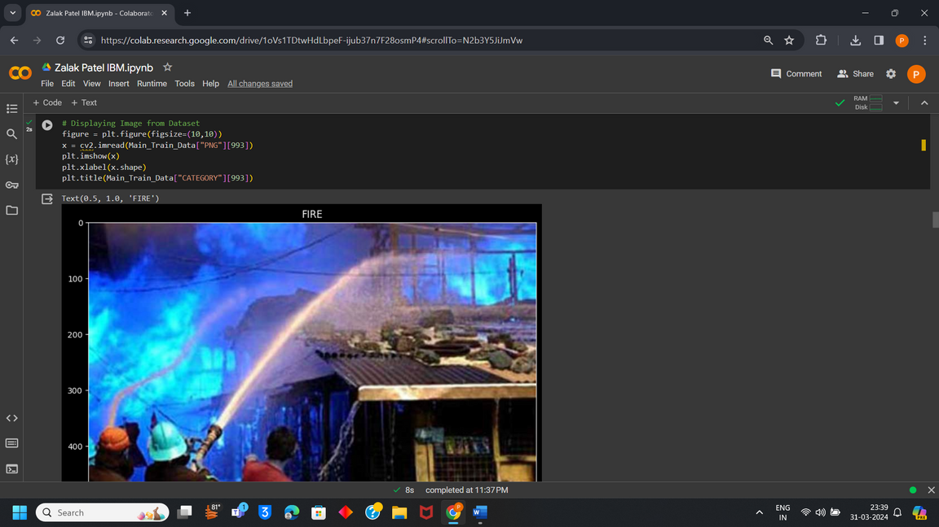
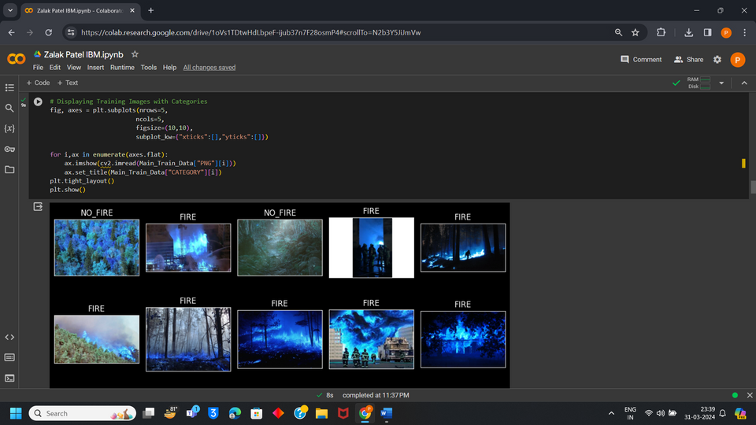
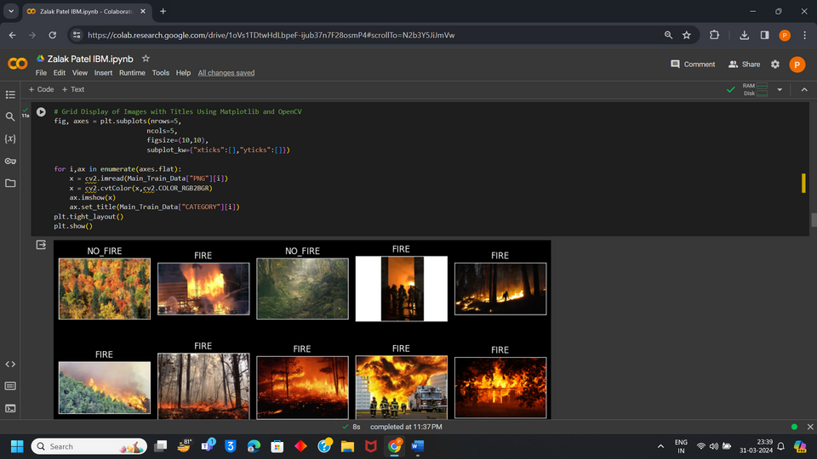
Few Images from Dataset:

Slide 9
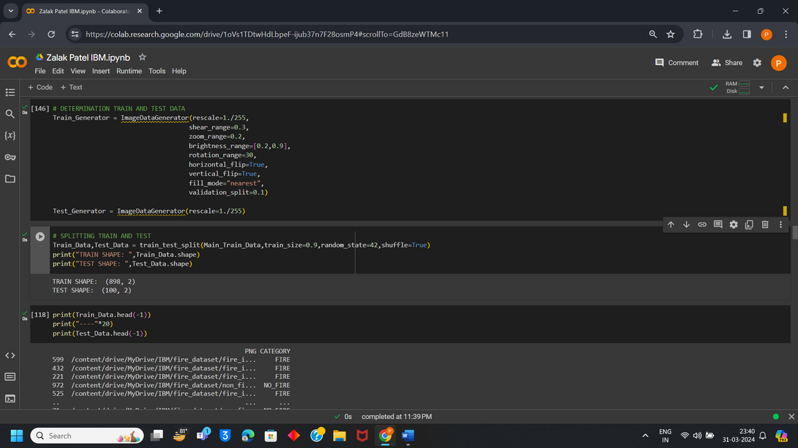
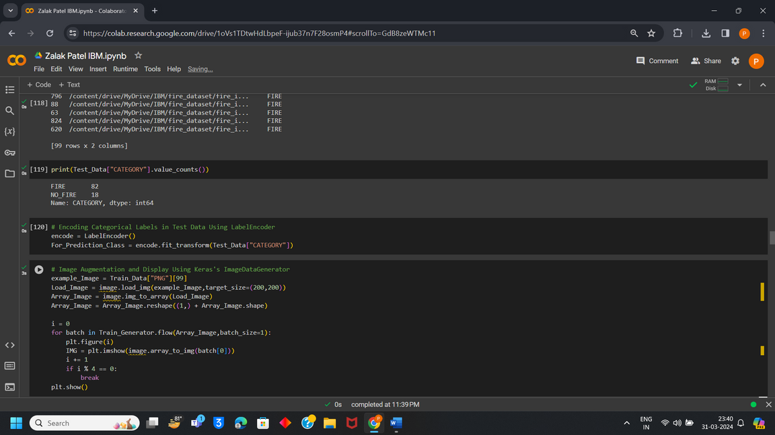
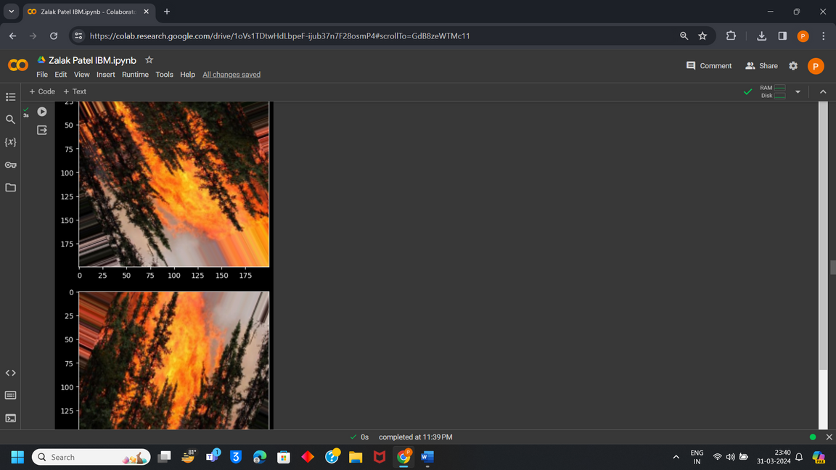
Train and Test Split from Data:

Slide 10
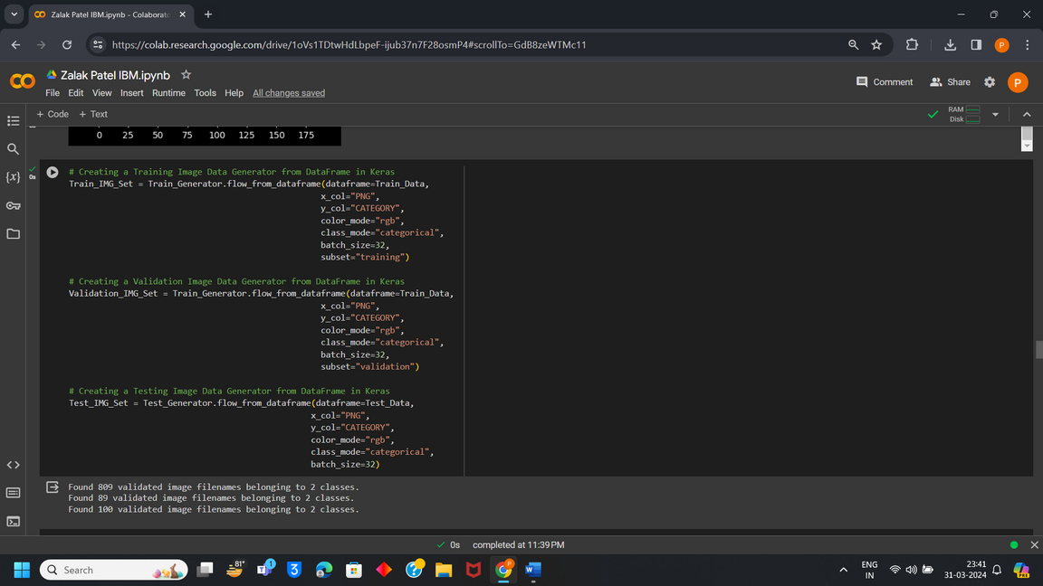
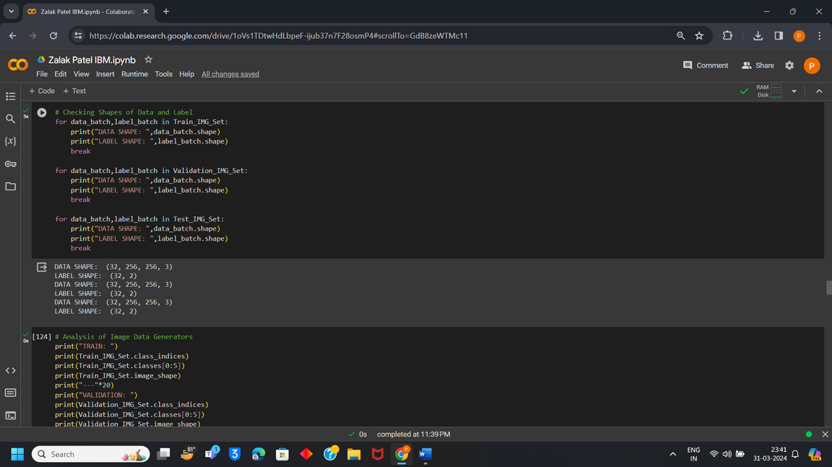
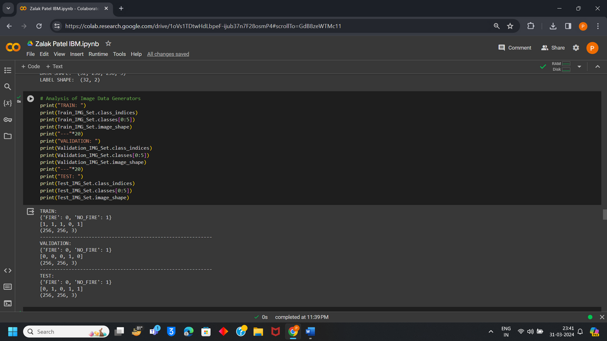

Slide 11
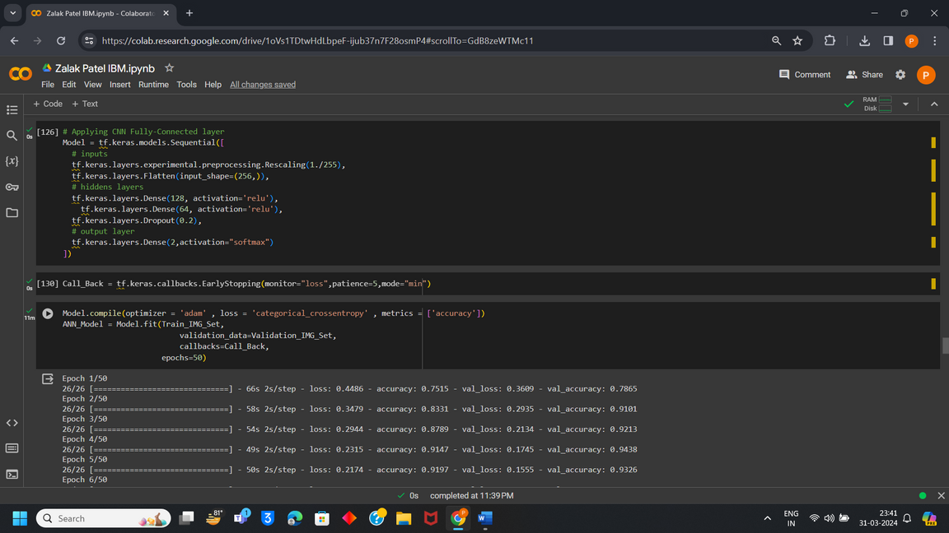
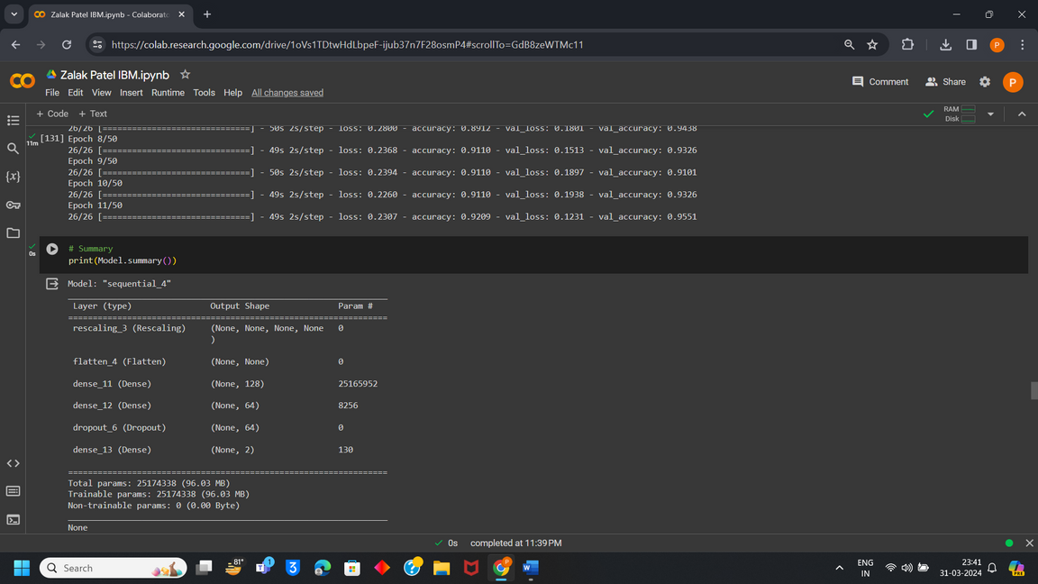
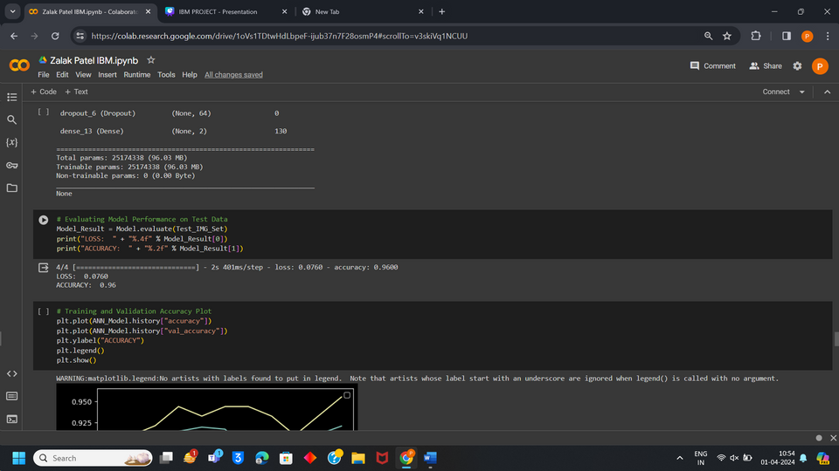
Model:

Slide 12
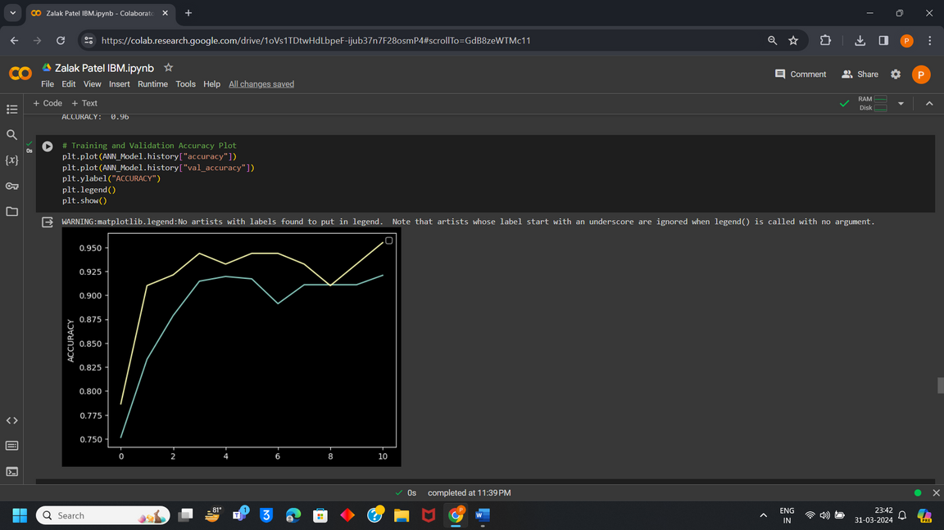
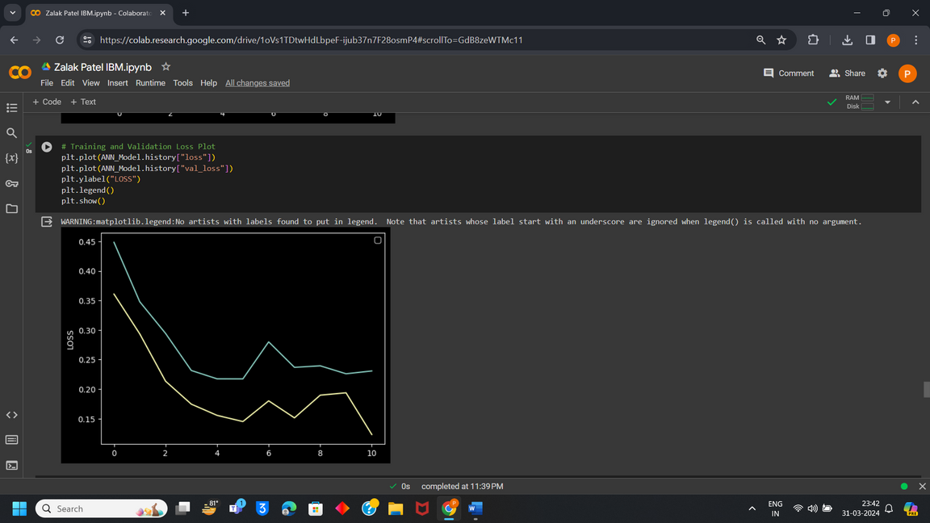
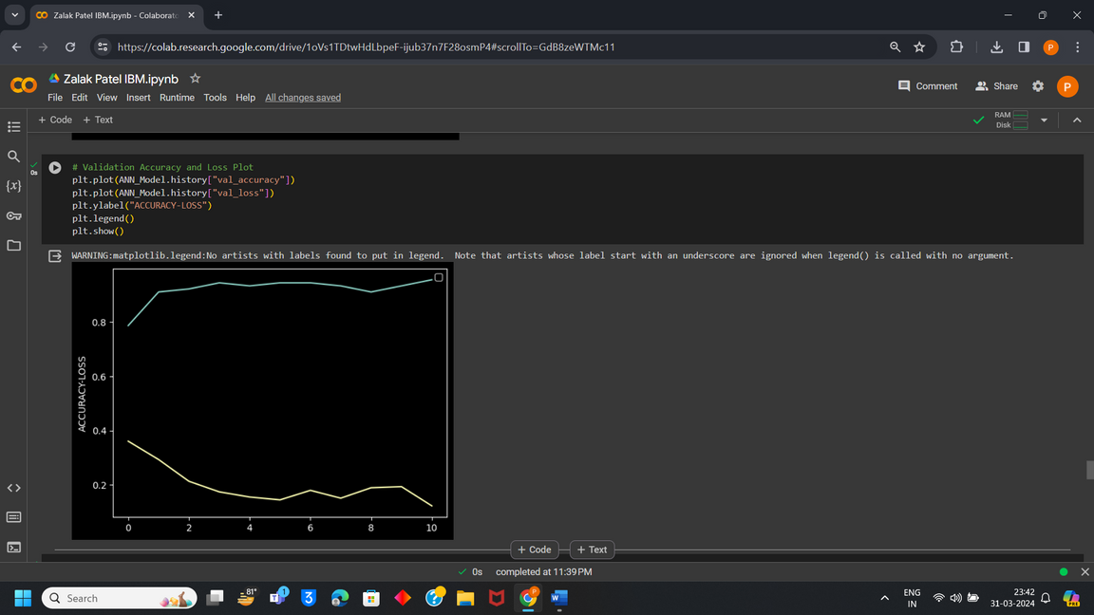
Accuracy and Loss Plot:

Slide 13
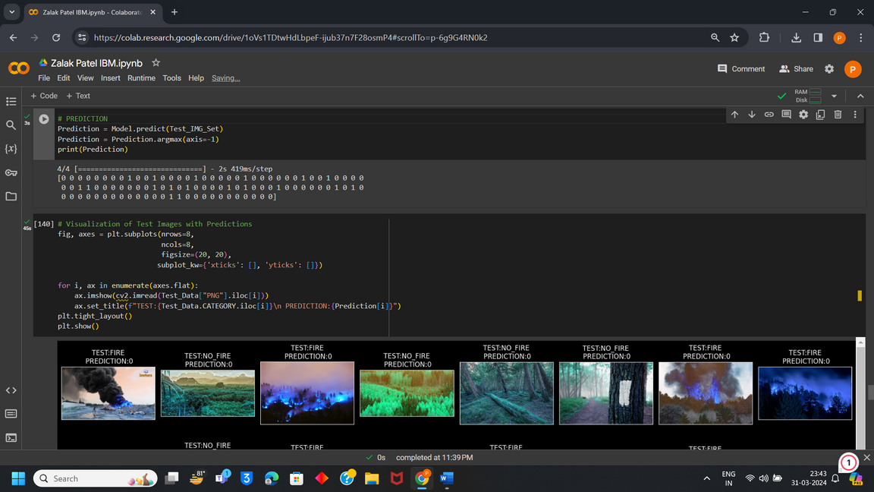
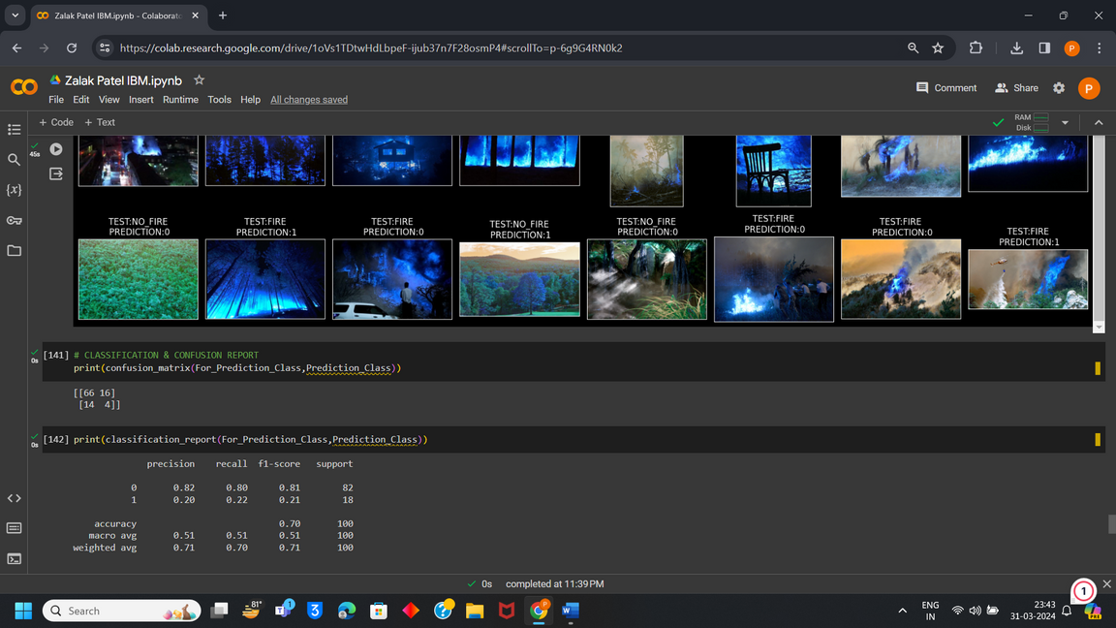
Prediction and Evaluation Metrics:

Slide 14
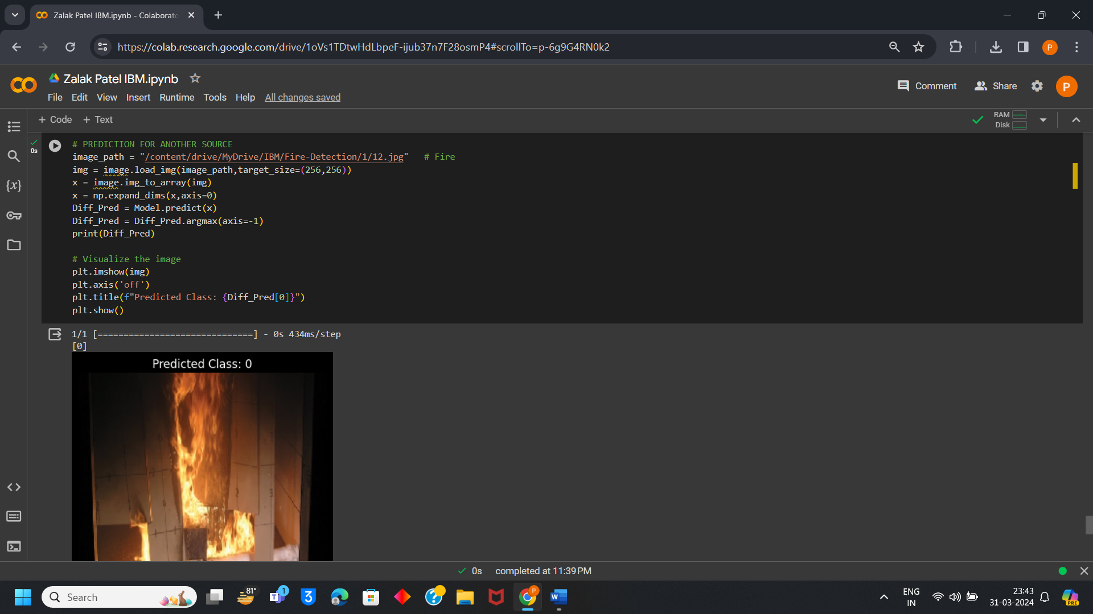
Prediction on unseen data:

Slide 15
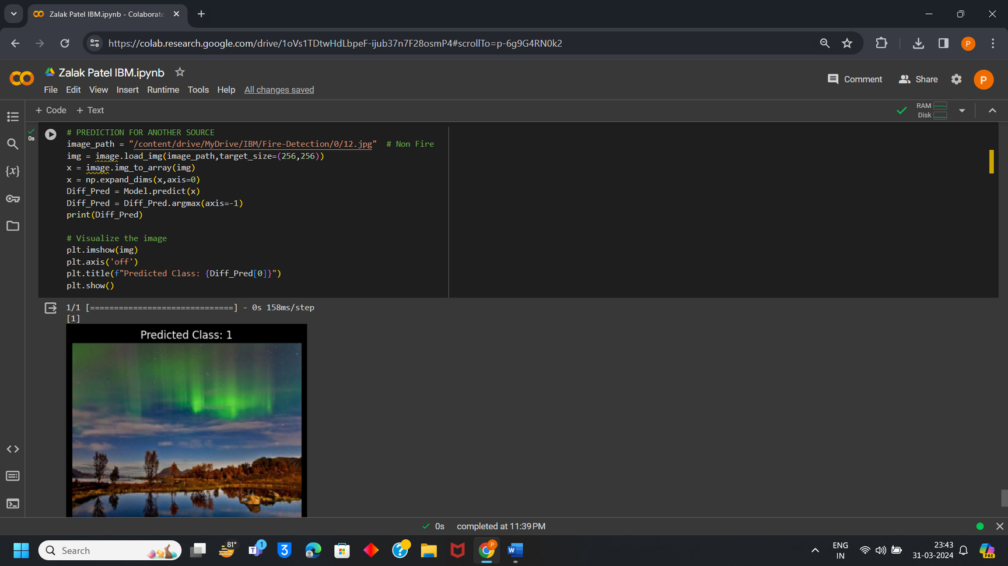
Prediction on unseen data:

Slide 16
Conclusion :
This Prediction is performed using Fully-Connected Layer in Convolutional Neural Network which is the part of Machine Learning. Forest Fire Prediction has 96 % accuracy in predicting fire in forests by visualizing images. This model is prepared which can work accurately even on unseen data.

